Slide 1
Agendas:
Introduction of NPESN website: https://npesn.isernepal.org.np
Overview of environmental research at ISER-Nepal
Exploring upcoming environment-related funding opportunities (including the Swiss-based Velux Stiftung Foundation)

Slide 2
Overview of Environmental Research at ISER-N
Dirgha J. Ghimire
Institute for Social and Environmental Research Nepal
University of Michigan
June 24, 2026

Slide 3
Goals:
                Map the landscape of environmental research at ISER-Nepal by reviewing ongoing work, emerging priorities, and areas of institutional strength.
                Share and assess existing resources including data, expertise, infrastructure, partnerships, and methodological tools that can support environmental research.
                Explore opportunities for collaboration to strengthen and expand environmental research through interdisciplinary partnerships, joint projects, training, and capacity-building initiatives.

Slide 4
Outline of Presentation
  Brief note on Global Environmental Dynamics Over Time
  Brief note on Nepal’s Environmental Dynamics and Challenges Over Time
  Overview of Environmental Research at the Institute for Social and Environmental Research Nepal (ISER-N)

Slide 5
Global Environmental Dynamics and Trends Over Time

Slide 6
Global Environmental dynamics
Global Environmental dynamics have shifted from mostly local resource degradation and pollution to planetary-scale environmental change
Over time, environmental issues have become more complex, interconnected, and political, involving not only ecology but also development, inequality, governance, technology, and global cooperation.

Slide 7
Nepal’s Environmental Dynamics and Trends Over Time

Slide 8
Nepal’s environmental concerns have shifted from land degradation and forest loss to complex challenges involving climate change, urban pollution, infrastructure development, conservation, and social inequality.

Slide 9
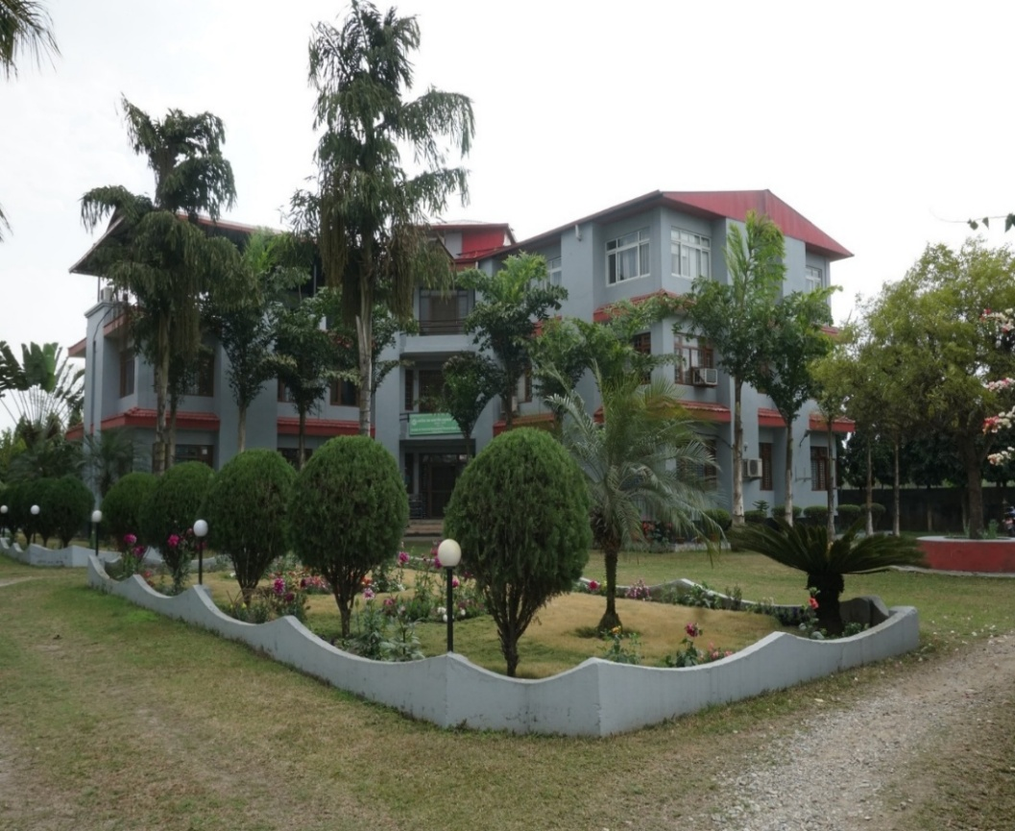
Institute for Social and Environmental Research Nepal(ISER-N)
The Institute for Social and Environmental Research Nepal (ISER-N) is a premier research and development institute dedicated to advancing knowledge about the connections among people, communities, and the environment in Nepal.
Through high-quality social, demographic, health, and environmental research, ISER-N supports evidence-based policies, programs, and sustainable development initiatives that address pressing social, public health and environmental challenges.
ISER-N collaborates with local communities and stakeholders, universities, research organizations, government agencies, and non-governmental organizations around the world. Its work includes field-based data collection, rigorous analysis, and capacity-building activities.
Improving Human Lives and Environmental Conditions
Through these efforts, ISER-N contributes to a deeper understanding of social change, environmental dynamics, family and community life, and public well-being in Nepal and beyond.

Slide 10
Approach
GOAL
A three-pronged, interlinked approach
Research
Capacity Building
Policy and Program Intervention

Slide 11
Institute for Social and Environmental Research Nepal(ISER-N)
The ISER-N’s features research areas:
Social Change & Family Dynamics
Childbearing, and contraceptive use
Marital and family relationships
Neighborhood, school, health, and bus service histories
Research Methodology
Survey Data for Agent-Based Modeling
Culturally appropriate translation of a survey questionnaire
Mixed Method Data Collection Strategies
Environment
Reciprocal Relationship between Population and Environment
Pollution & Human Health
Foundations for Conservation Action
Migration
Education
Health
Family Migration Context & Early Life Outcomes
Labor Out-Migration and Food Security
COVID-19 & Migration
Accountability Measures & Students’ Achievement
Parental Education & Child Development
Child Health
Parental Mental Disorders & Family Formation
Psychological Stress in transition to adulthood
Alzheimer's Disease & Dementia Risk
Notes:
The sampling was undertaken in 1995 with a systematic, equal probability selection of tols (natural clusters of households surrounded by farmland, similar to a small village). The result is a population-based probability sample of 151 tols, with stratification by distance from the urban center and oversampling to ensure high levels of variance in key dimensions of social context and change. The 1996 sample was refreshed in 2008 by adding new individuals who aged into the sample (age 15) and/or who moved into the sample neighborhoods.

Slide 12
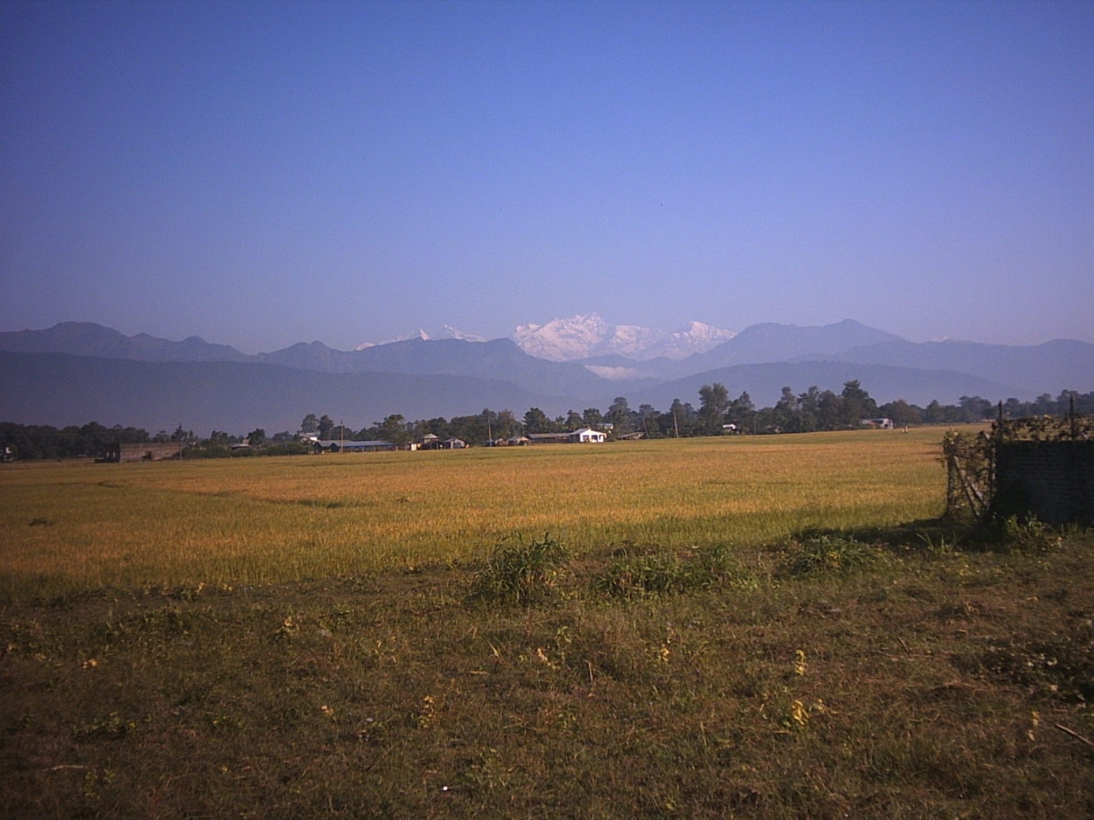
Chitwan Valley Family Study (CVFS)
The CVFS is a 30-year long omnibus family and community panel study of a representative sample of the Western Chitwan.
Located in south central part of Nepal, a new settlement area, western Chitwan offers a unique social laboratory with diverse socio economic and ecological context.
CVFS study design involves: case control, multilevel, multimode data collection panel.
Notes:
The sampling was undertaken in 1995 with a systematic, equal probability selection of tols (natural clusters of households surrounded by farmland, similar to a small village). The result is a population-based probability sample of 151 tols, with stratification by distance from the urban center and oversampling to ensure high levels of variance in key dimensions of social context and change. The 1996 sample was refreshed in 2008 by adding new individuals who aged into the sample (age 15) and/or who moved into the sample neighborhoods.

Slide 13
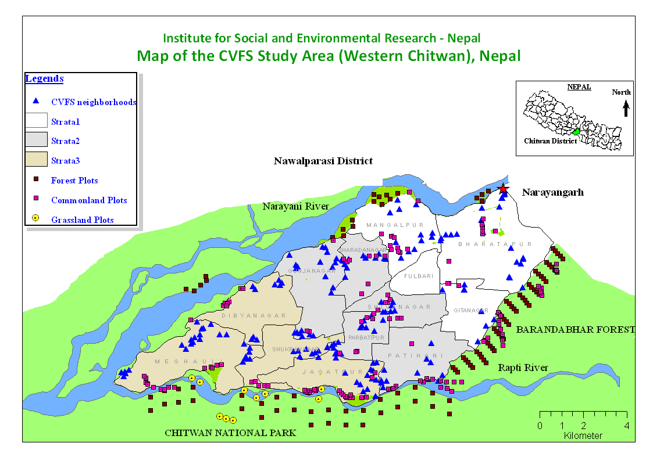
CVFS Sample
151 Neighborhoods
1580 (1996), 4146 (present) Households
4646 individuals age- 15-59
265 Flora plots
Census of all:
      Schools (186)
      Health service (268)
      Transportation ( 21 bus routes)

Slide 14
Research Design
Multi-level
Longitudinal Panel
Mixed Method Data Collection
Multi Mode Data Collection

Slide 15
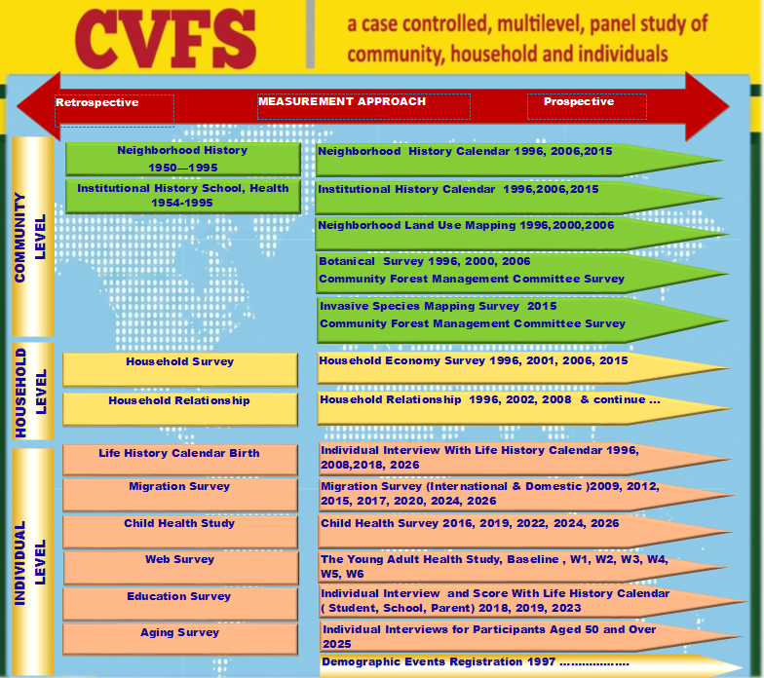
CVFS is a comprehensive family panel study of individuals, households, and communities in the Chitwan Valley of Nepal.

Slide 16
Mixed Methods
Archival
Ethnography
Cognitive Interview
Focus Group Interview
Purposive Group Interview
Individual – Survey, Clinical
GIS/GPS, Remote Sensing
Camera Trapping
Direct Observation and Measurement
Laboratory
Web survey (Self Administration )

Slide 17
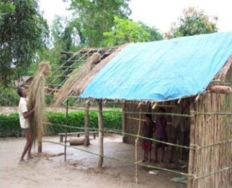
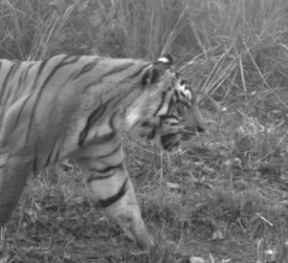
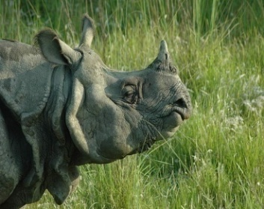
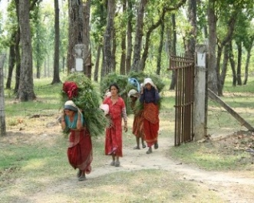
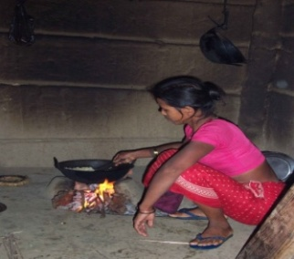
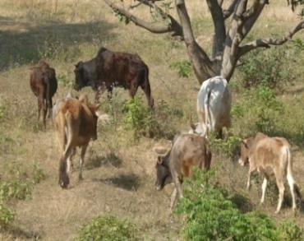
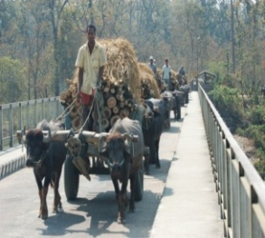
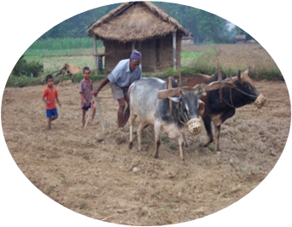
Environmental Research
Study of Reciprocal Relation between
Population and Environment

Slide 18
ISER-N: Environment Research Studies
Time Period | Project | Funding | Key Trends | PI
1995-2007, 2009-2012 | Reciprocal Relationship between Population and Environment | NIH-NICHD | To examine the relationship between population change and environment change | Axin, Shivakoti, Ghimire, Dangol
2004 | Arsenic Content in Groundwater | ISER-N | To measure arsenic contamination levels in groundwater sources | Ghimire
2007-2012 | NSF Partnership for International Research and Education (PIRE) Collaborative Research and Training in Social context, Population and process and Environment Change | NSF | A novel, interdisciplnary and international multi-site project for comparative studies on population-environment instruction by linking two separate state-of-the-art and will-stablished international research programs in Nepal and China | Axin and Lui
2012-2017 | Coupled Nature Human(CNH) Feedbacks between Human Community Dynamics and Socio-ecological Vulnerability in a Biodiversity Hotspot. | NSF | What factors lead to vulnerability of community forest (CF) socio ecosystems to the catastrophic effects of unexpected natural events ? | Yabiku
2012-2016 | Investigation of Indoor solid Fule and Kerosene use as Ttuberculosis Risk Factors. | NIH NIEHS | To investigate whether household use of biomass or kerosene fuel for heating, cooking, or lighting increases the risk of tuberculosis infection or disease. | Bates
2016-2018 | Investigation of Ocular Disease and Household Fule Use in Kaski | NIH | To examine whether household fuel use for cooking, heating, and lighting is associated with cataract (ocular lens opacity) among women in Kaski district. | Bates
2016-2017 | Investigation of Household Air Pollution and Cardio Pulmonary Diseases in Kaski | NIH | To investigate the relationships between fuels used for cooking and clinical and subclinical cardiovascular changes, including hypertension, left ventricular mass, diastolic dysfunction, pulmonary artery systolic pressure, and ankle brachial index, among individuals using solid fuels compared with gas fuels. | Bates
2021-2022 | How Does Climate Change Effects Nepali Farmers' Livelihood Choices | NSF/PU | To understand how people of the Chitwan Valley make decisions regarding economic livelihoods, and the role of climate change and other factors in these decisions. | Choquette-Levy
2023 | Adolescent Compliance with Wrist-Based Air Population Detector | UM | To understand the impact of household and ambient air pollution on adolescent health and well-being. | Jagger
2023 | CNH2: Study on People, Place, and Payments in a Complex Human-Environment System in Eastern Chitwan | NSF | To evaluate the role of payment for ecosystem services on household economic strategies, livelihoods, community forest participation, environmental attitudes, and investment in children’s well-being, including schooling and time-use, among households in Chitwan. | Glick and Yabiku
2023-2024 | Integrating Natural Hazards Engineering and Social Demographic to Identify Cumulative Consequences of recurrent Flooding | UM | To identify and assess flood exposure in the CVFS neighborhoods from 1995–2024 using community-based methods and remote sensing, and evaluate the impacts of recurrent flooding on long-term population dynamics, health, and wellbeing outcomes among CVFS neighborhoods. | Loos, Axinn and Ghimire
2024 | Enhancing Social Resilience to Human-wildlife Conflict Risk Study | UM | To understand the social and ecological characteristics affecting social resilience in the village near the national park with varying numbers of tiger presence in Nepal considering current tiger population levels and projected future increases. | Zuckerwise

Slide 19
Reciprocal Relationships between Population and Environment.
Objectives (first phase: 1995 -2000)
To examine
i) The relationships between population change and environmental
change by determining the extent to which changes in marriage timing,
household fission, childbearing and migration influence,
ii) And are influenced by, changes in land use, water quality and flora diversity,
and the extent to which these relationships are produced by exogenous changes
in the social and institutional context.

Slide 20
Reciprocal Relationships between Population and Environment.
Objectives (second phase 2001-2007)
The primary aim of this project is to analyze these existing data to address four specific questions regarding the reciprocal relationships between population processes and the environment:
    To what extent do marriage timing, household fission, childbearing, and migration influence land use and flora diversity?
  2) To what extent do land use and flora diversity influence marriage, household fission, childbearing, and migration?
  3) To what extent do agricultural practices and consumption patterns link population processes to environmental outcomes?
  4) To what extent are the observed relationships between population processes and the environment produced by exogenous changes in the social, economic and institutional context?
  Our second aim is to extend these unique population and environment measures forward in time.
  The third aim is the systematic application of ethnographic methods to gather information to redesign our survey measures of the factors linking population and the environment in an effort to improve our models of these processes.

Slide 21
Reciprocal Relations between Population and Environment at the Micro-Level
Conceptual Framework

Slide 22
Data: Population
  Periodic Thematic Individual Surveys ( 1996, 2008, 2016, 2025) cross section surveys
  Prospective Monthly Household Registry (1997 – to date 351 months)
  Birth, Marriage, death, living arrangement (migration) and education.
  Contraceptive Use (1997-2017 )
  Marital Arrangement Survey (2006-Ongoing)
  Spouse choice, husband-wife communication, inter-caste marriage, gifts, marital satisfaction
  Household Relationship (1996, 2002, 2008 – Ongoing )
  Migration Spell Survey - Away Sheet (Months 1-36, Month 145- Ongoing)
  Location, contact information, when left, reason for leaving, and return plan

Slide 23
Data: Environment
  Neighborhood Land Use (1995, 1999, 2006)
  Land area, cultivated land, plantation, canal, road, building, and infrastructures
  Flora Plot and Common Land Plot Flora Survey1996, 1999, and 2006)
  No. of plants by species (herb, shrub, tree)
  Household Consumption and Agriculture Survey ( 1996, 2000, 2006 and 2015)
  Farming, livestock, household assets, migration, perception of changes in environment, farming problems, income and consumption
  Seasonal Agriculture Survey 1997 – 1999 ( nine seasons)
  Crops, area, production, labor use, use of tractor, fertilizers, pesticides, irrigation, consumption, etc.
  Weather Data (secondary source) (1967-2017)
  Temperature, Rainfall, and Relative Humidity

Slide 24
Data
Community level data
  Neighborhood History Calendar (1996, 2000, 2006, 2015), with GPS coordinates
  Distance to the nearest city, distance to the nearest services: such as school, health service, movie, bus, mill, market, cooperative, employment, bank, police, temple, etc. each year from 1951 to 2015
  School History Calendar and School Survey (1996, 2000, 2006 and 2022)
  History, grades, classrooms, teachers, students, tuition, curriculum, medium of instruction, etc. annually from 1951 to 2015
  Health History Calendar ( 1996, 2000, 2006 and 2015)
  History, services, infrastructure, contraceptives, child immunization, maternal/child health, mobile camp, etc. annually from 1951 to 2015
  Public Transportation History (1996)
  Service date, fare, and time to destination in 1996
  Bank History
  Hotel History Calendar

Slide 25
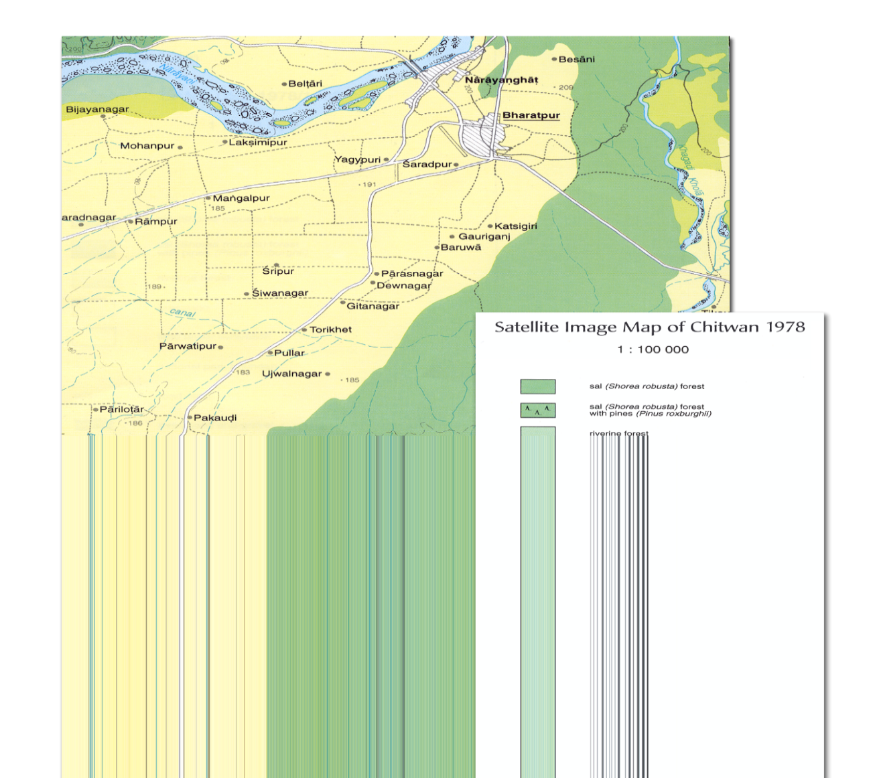
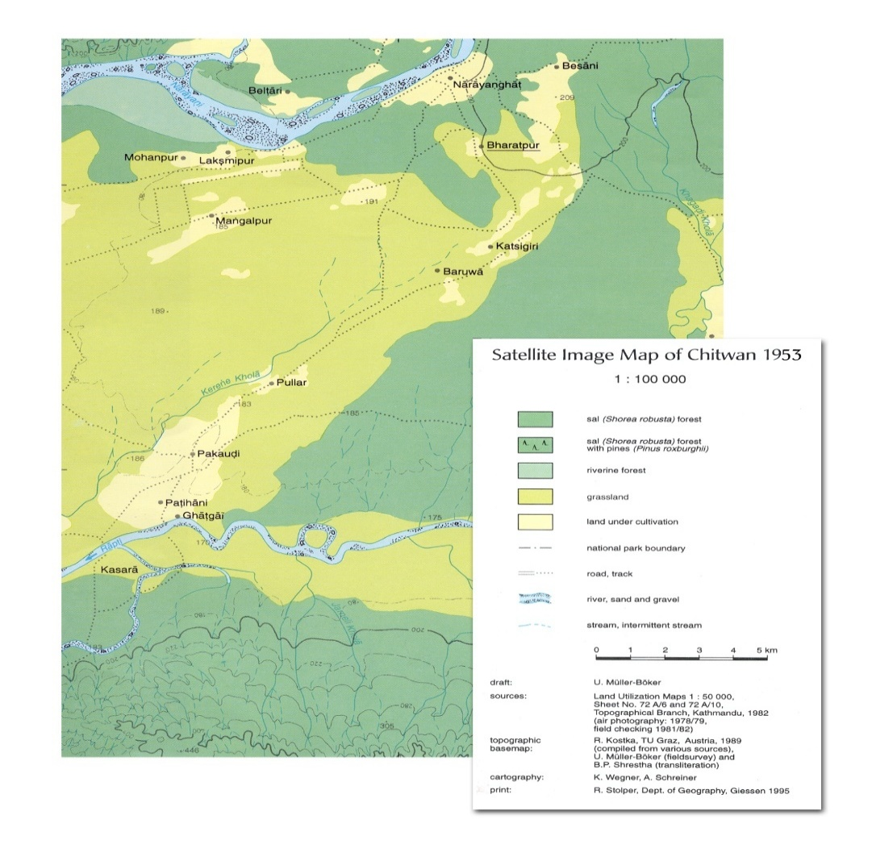
Land Use Chance in Chitwan 1953-1978
1953 1978

Slide 26
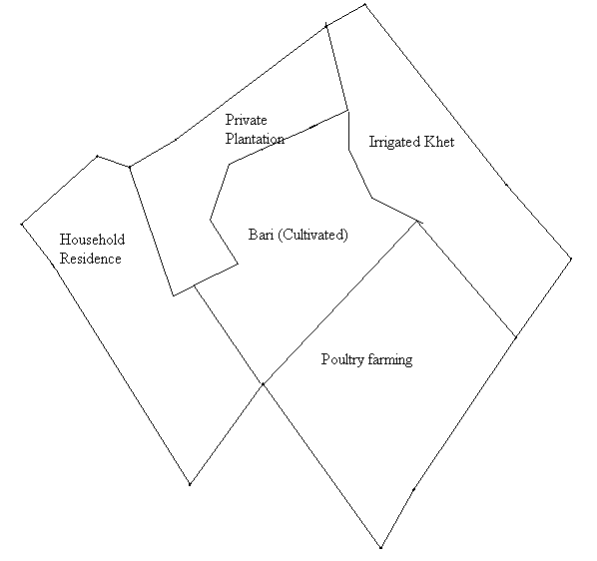
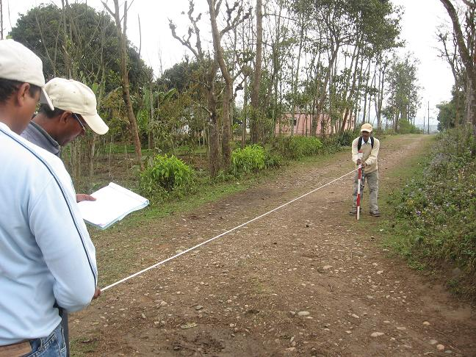
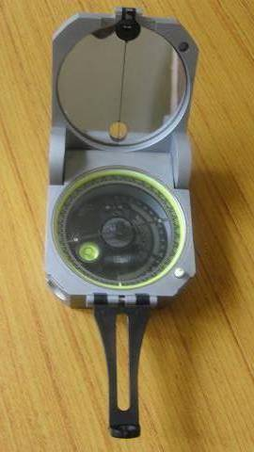
  Neighborhood Land Use Mapping (1996, 2000, and 2006)
1) Finding the Neighborhood Location and Boundary
Total Neighborhoods- 171
2) Data Collection
  GPS Information of boundary points
  Measure Distance and Bearing
  of Neighborhood boundary and
  perimeter of all land use categories.
Notes:
26

Slide 27
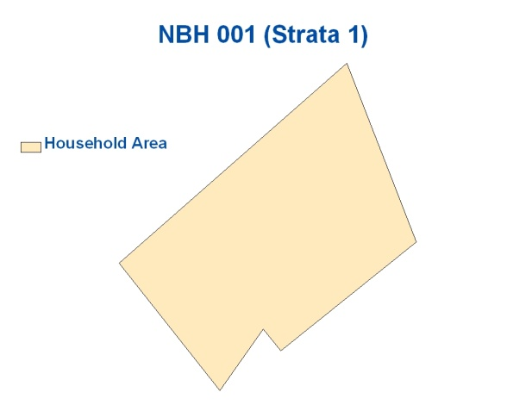
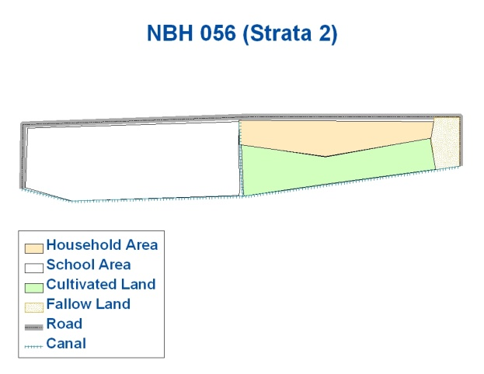
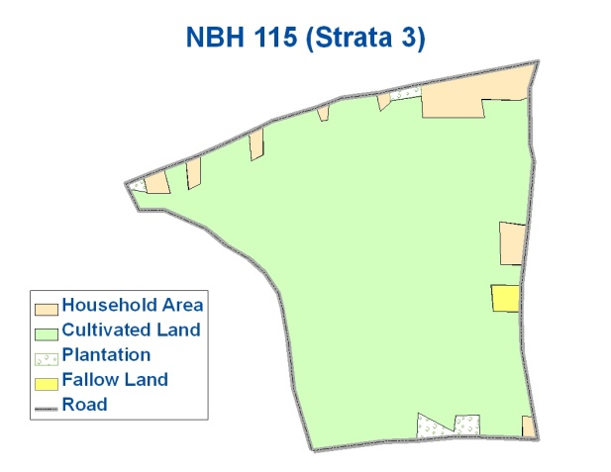
  Neighborhood Land Use Mapping
Notes:
The procedure is similar to previous slides.
But when we click on the circles first, it shows the NBH Land Use type at once and make easier for comparison.
When we click on the NBH map, it disappears.
27

Slide 28
Environmental sample

Slide 29
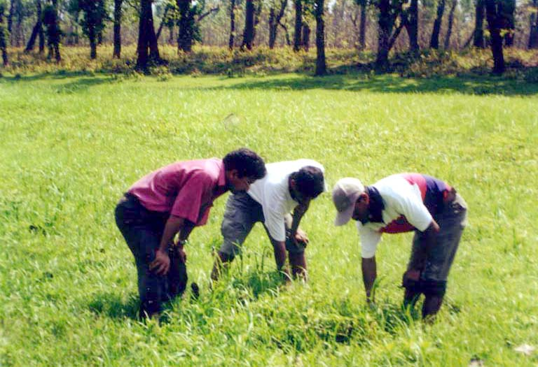
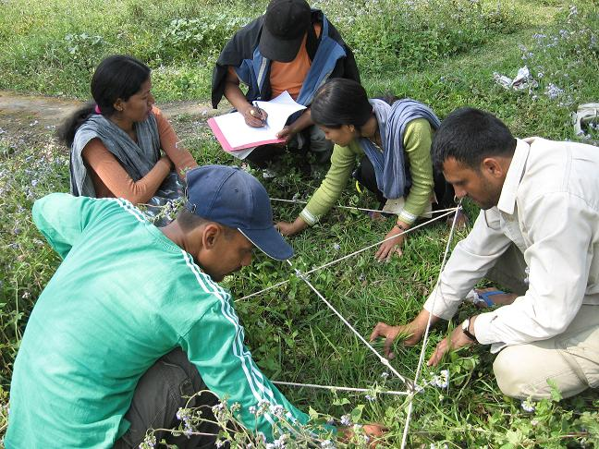
Methodology
Sampling design
  Systematic sampling method
  11 transects at a distance of 1000 m
  5 plots in each transects at a distance of 250 meter
  Plots-nested quadrats
Data Collection
  Species, population, DBH, height
  Species, population and cover %

Slide 30
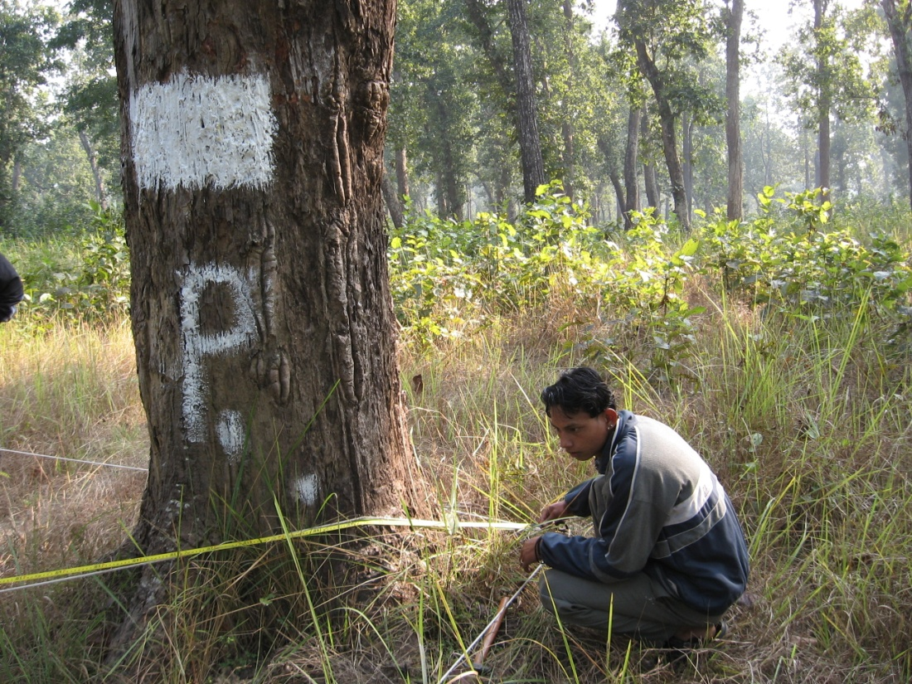
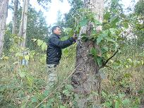
  Flora data collection
1) Research plots (Total research plots – 265)
a) Barandabhar Buffer Zone Forest - 62
b) Chitwan National Park (CNP) – 34
c) Forest along the Narayani River – 21
d) Grassland in CNP – 10
d) Common Land – 138
2) Data
Species, population, DBH, height
  Species, population and cover %

Slide 31
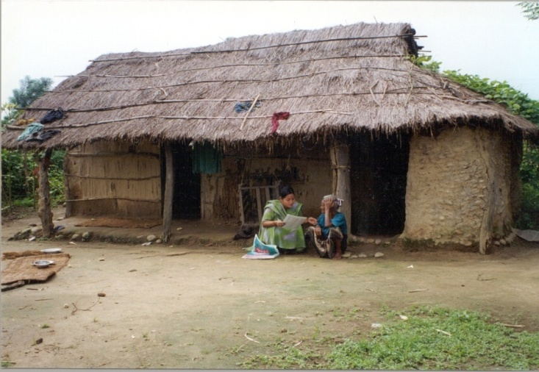
  Household consumption and agriculture survey ( 1996, 2000, 2006 and 2015)
Household Consumption Survey : This research examines the reciprocal relationships between population dynamics, agricultural land use, and environmental change in western Chitwan Valley, Nepal, with a focus on household-level livelihoods and land-use practices. A longitudinal household survey collects information on agricultural activities, livestock ownership, household assets, migration, perceptions of environmental change, farming constraints, income sources, and household consumption, following households over time to generate panel data for analyzing socioeconomic and environmental changes at the household level.
Labor Outmigration, Agricultural Productivity and Food Security Survey : The purpose of the study is to understand better impact of labor out migration and remittance on agriculture productivity, women's participating on farming, exit from farming and farm technology use. We collected information about farming, crop plantation and production, technology use in farming, livestock and remittance by using the household agriculture calendar.
Notes:
Our measures of flora come from hand counted botanical counts of flora from 265 sample plots. We use two different aspects of flora: density and diversity. By flora density we refer to total number of plants per unit area.
The flora diversity on the other hand refers to composition of species in a sampled area. Thus diversity indices are the ratios between the numbers of species. Although there are a number of diversity indices, we use Shannon diversity index for simplicity, which essentially suggest that larger the diversity index number more equally different species are distributed.
To count number of different plant species we use three types of sampling units (quadrats) (a)10 x 10 m² plots for trees and woody climbers (b) 3 x 3 m² plots for shrubs, saplings of trees and herbaceous climbers and (c) 1 x 1 m² plots for herbs and seedlings of trees, shrubs and climbers. The hand counting of each and every single plant provides uniquely detail measures of flora density and diversity. In addition, the hand counting of flora was repeated in 2001, after five years following the same procedure by the same group of botanists as in 1996. This recounting of the flora provides precise measures of change in both flora density and diversity over a five year period. Because of the time series data, it allows us to control for flora density and diversity in time-one and precisely examine the impact of population process on flora (density and diversity) later in time-two.

Slide 32
Household Agriculture & Consumption Survey
Farming, livestock, household assets, migration, perception of changes in environment, farming problems, income and consumption (1996, 2001, 2006 (Panel))
Seasonal Agriculture Survey
Crops, area, production, labor use, use of tractor, fertilizers, pesticides, irrigation, consumption. (1997, 1998, 1999 & 2016 (Panel))
Measurement of Remittance Use in a Remittance Dependent Economy (2013)
Household Livelihoods/Farming, Migration, Remittance Use
Labor Outmigration, Agricultural Productivity and Food Security Survey (LOAF): Seasonal Agriculture Survey (2015-2017)
Crop Production, Crop Currently Planted, New parcels, Remittance
Baseline HH Livelihood & Food Security (2015-2017)
Livelihood & Food Security
Crop yield Measurement Survey (2015-2017)
Type of Land, Fertilizer, Name of the variety, Type of seed, Moisture percentage, Productivity
Woman Time Use Survey (2015-2017)
Women-Time Use in a Day, Women-Time Use in a Month

Slide 33
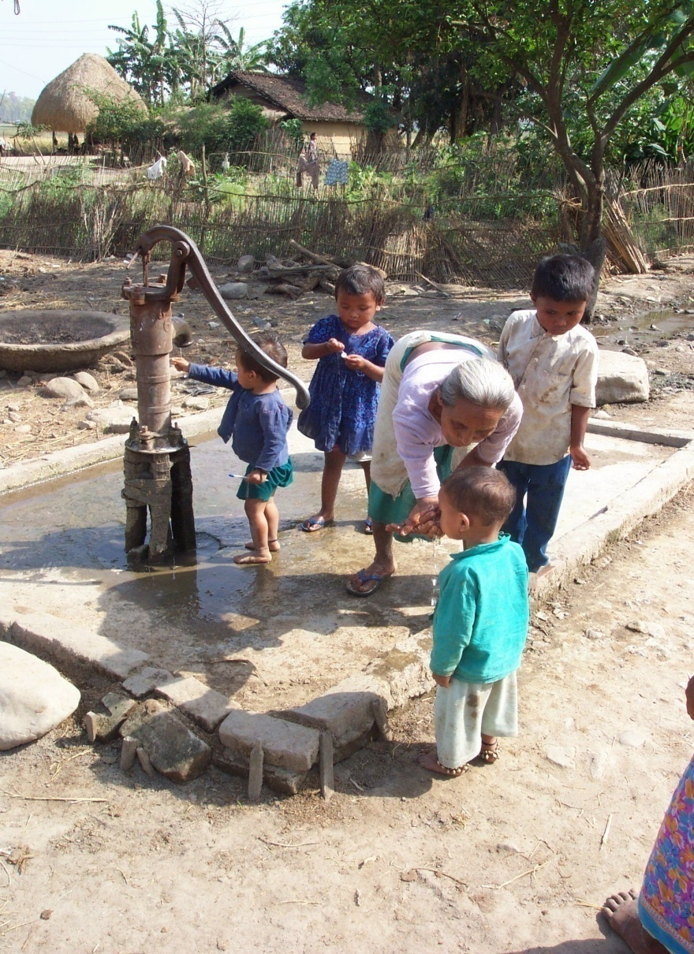
Arsenic Content in Ground Water
Collected samples from 1,445 drinking water sources used by over 2015 households living in the study area to test the arsenic content.
Results:
Among total sampled water sources, three water sources used by ten households had arsenic concentrations above the drinking water standard of 10 ppb. Arsenic levels of 20 ppb were detected in 2 water sources which is used by 4 households , while 40 ppb was detected in 1 water sources used by 6 households .

Slide 34
NSF Partnership for International Research and Education (PIRE) Collaborative Research and Training in Social Context, Population Processes, and Environment Change
The research objectives are to:
    improve case-specific understanding of patterns and processes affecting vegetation and habitats for three important endangered species (pandas, rhinos, and tigers);
    2) achieve cross-case comparison of these dynamic patterns and processes;
    establish widely applicable tools needed for cross-case comparison in population- environment interaction.
Our educational objective is to train a new generation of scientists skilled at conducting new international cross-case comparisons of human-environment interaction. The educational activities will be closely integrated with research activities, with a focus on learning and practicing the concepts and methods needed to bridge key disciplines and foster close international collaborations.

Slide 35
NSF –PIRE: Collaborative Research and Training in Social Context, Population Processes, and Environment Change
  Tiger Human Interaction Study (2009-2010)
  Ecosystem Services and Population Change (2009)
  Mapping Wildlife Habitat in Chitwan (2011)
  Climate Change, Vulnerability and Adaption in Chitwan Valley (2011)
  Satellite Imagery (IKONOS) 2010 NSF-PIRE 11 IKONOS images

Slide 36

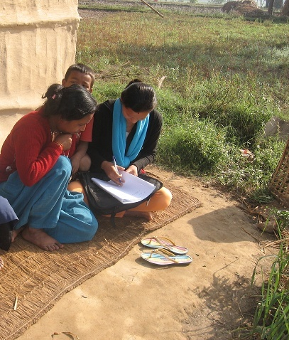
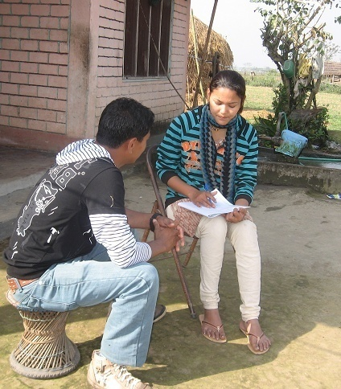
  Tiger-Human Interaction Survey
1) Camera Trapping of Tiger
2) Tiger Tolerance Survey
3) Community Forest Mapping and Survey
Camera

Slide 37
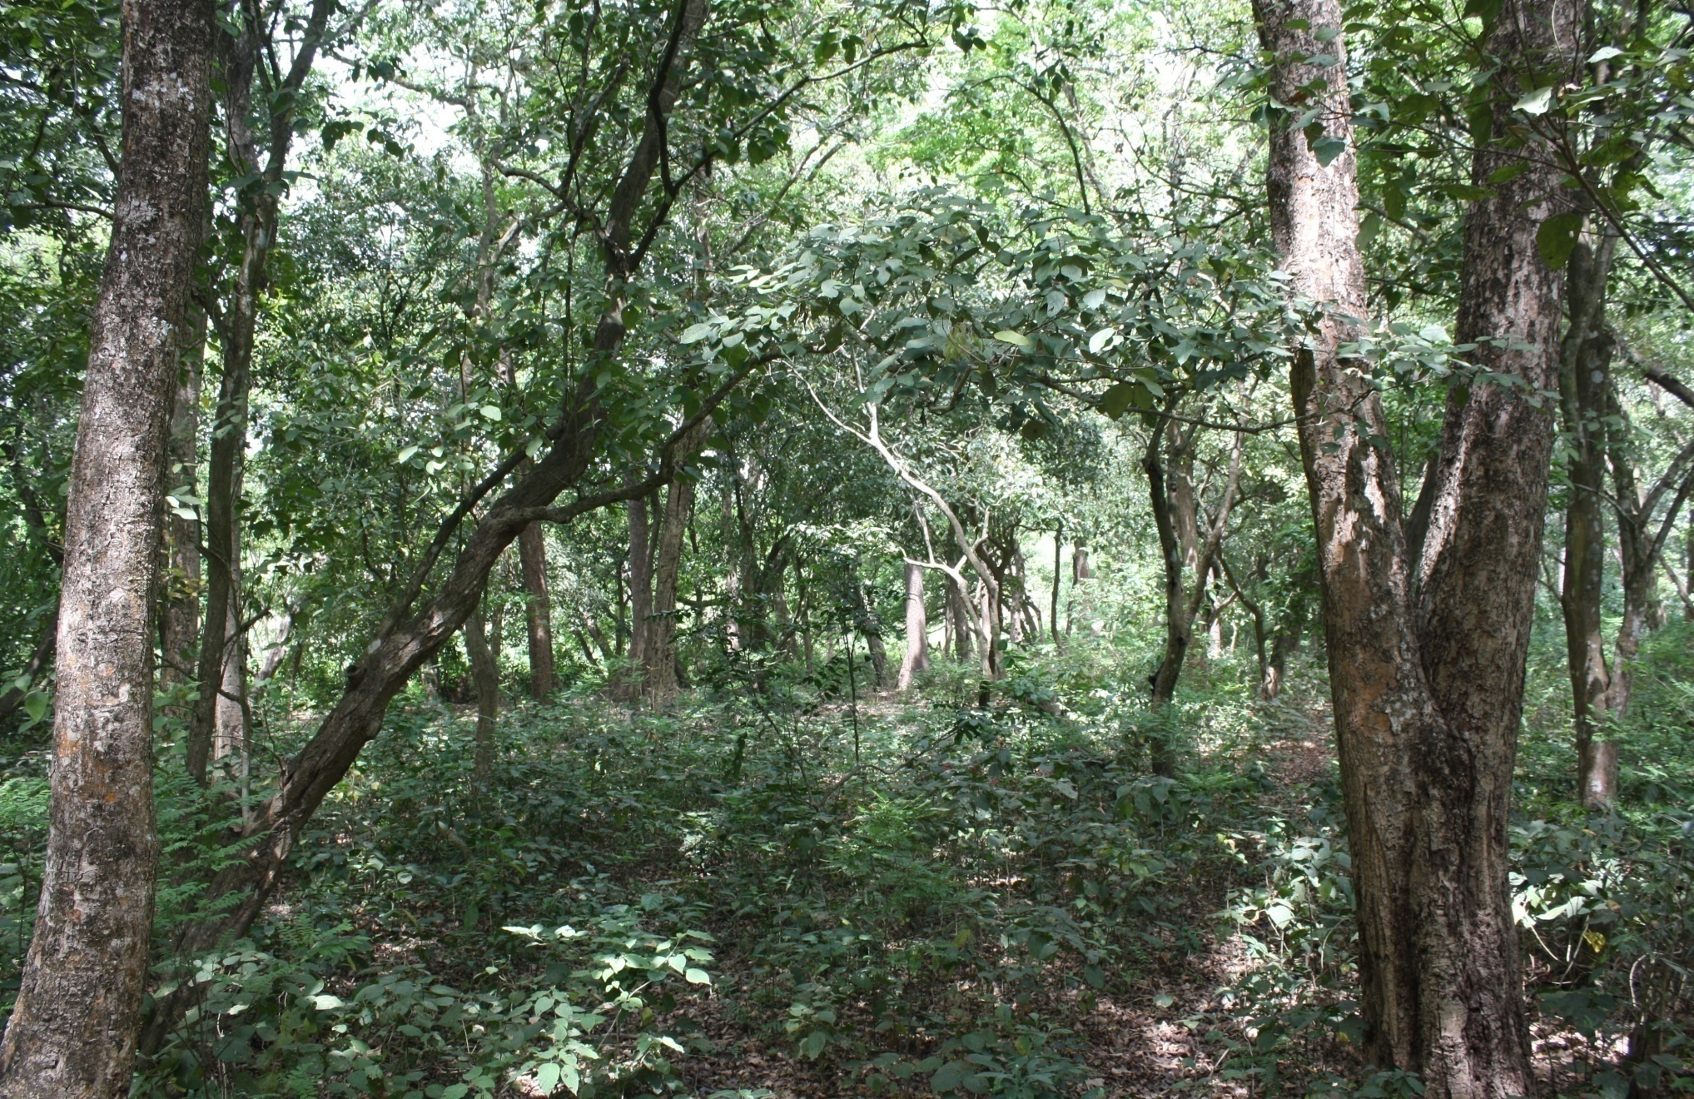

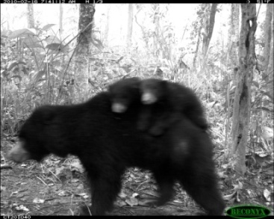
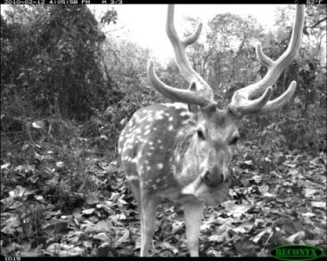
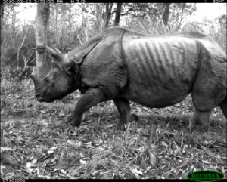
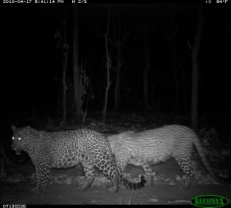
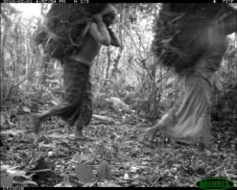
  Tiger-Human Interaction Study Camera Trapping
Bear with cubs
Chittal
Tiger
Leopards
Rhinoceros
People carrying grass
Notes:
Ask about the photo what you think? Then explaining about the importance of a forest for wildlife and human. Also discuss about the objectives, methods and the preliminary result (As Neil presented in Kathmandu) eg. People of western Chitwan do no worry about the tiger and more than 90% people answered that they like to protect
Tiger in all forests where tigers are found.
37

Slide 38
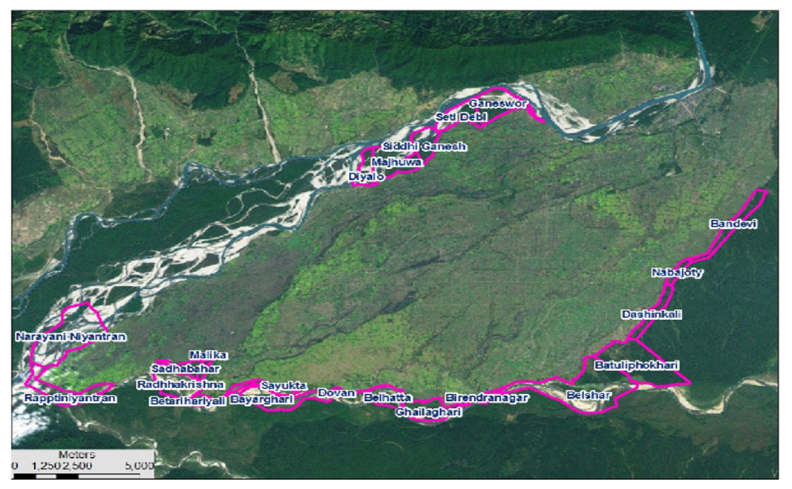
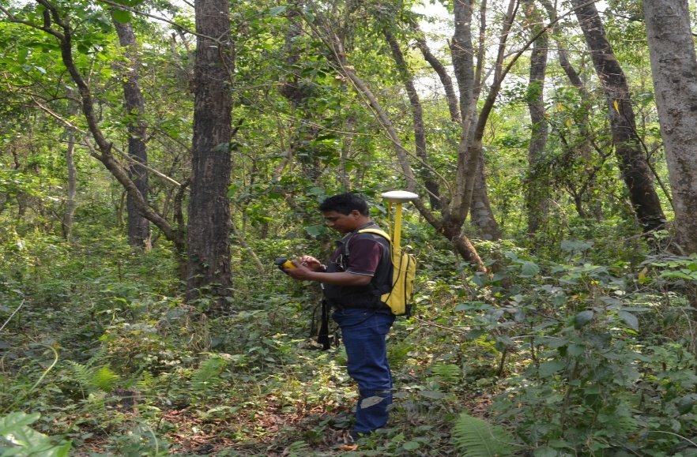
Community Forest Mapping and Survey

Slide 39
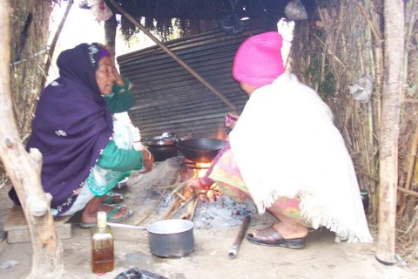
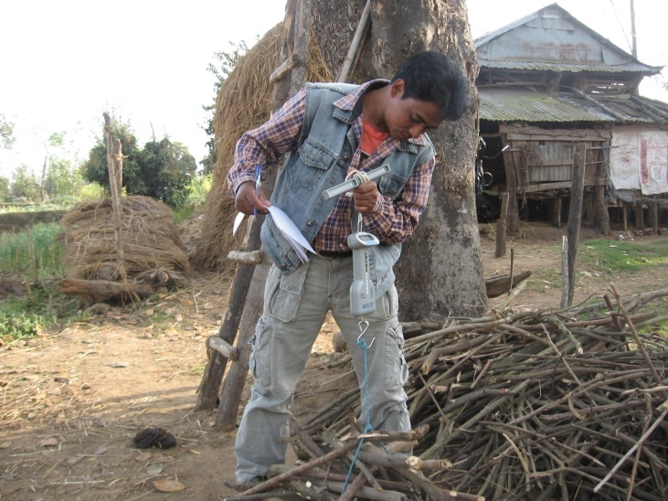
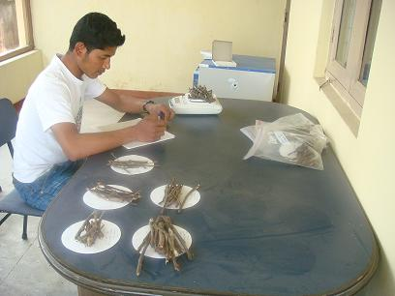
Ecosystem Services and Population Change
Fuelwood Consumption Survey
  Fuelwood use
  Demand and Supply
Forest Biomass Research
  Tree species diversity
  Demography and
  Woody biomass estimation

Slide 40
Mapping Wildlife Habitat in Chitwan -2011
Study of land cover change of wildlife habitat in Barandabhar Forest, Chitwan.
Objective: Produce a high-resolution land cover map Barandabar forest from the satellite imagery and Quantify land cover change (excluding urban/agricultural areas) from 2000-2010.
Data collected from the 150 GPS points in Barandabhar Forest

Slide 41
  Climate Change, Vulnerability and Adaption in Chitwan Valley (2011)
Primary objective
This study, led by Principal Investigator (PI) Alex Zvoleff, aimed to assess vulnerability to environmental change, including climate variability and change, in the western Chitwan Valley by examining livelihood strategies, mapping land use and land cover (LULC) change, characterizing climate and stream flow trends, and analyzing the effects of climate processes and events on local and regional migration using integrated social and biophysical data.
Study the general climate change pattern, its impact and local initiatives to cope with the impacts
Study area– Western Chitwan
Information collection from 294 households

Slide 42
CNH: Feedbacks between Human Community Dynamics and Socio-Ecological Vulnerability in a Biodiversity Hotspot
Goals
What factors lead to vulnerability of community forest (CF) socio-ecosystems to the catastrophic effects of unexpected natural events?
What coupled human-natural factors regulate the differential vulnerability of CFs to rapid biological invasion and degradation of ecosystem services?

Slide 43
Primary objectives
Examine the bidirectional relationships between exotic plant invasion and a suite of social-ecological variables, including biophysical, household, and community characteristics, land use history, and non-family social organizations and institutions, across 21 heterogeneous community forests in the buffer zone of Chitwan National Park.
Test the strength of biophysical and social factors related to CF vulnerability through true experiments, including a common garden study and an educational intervention designed to slow exotic species invasion and restore ecosystem services.
Use agent-based modeling to synthesize new findings with existing data and evaluate scenarios of feedbacks between social-ecological properties, non-family organizations and institutions, adaptive management of invasive species, and forest services.
Train a new cohort of junior scholars for interdisciplinary careers by involving them in international research focused on theory and solutions to complex, real-world problems.

Slide 44
Socio-ecological systems of increasing complexity: Buffer zone communities of the Chitwan Valley
External forces:
In-Migration
Habitat quality for rhino, tiger, and other wild animals
–
Crop raiding by wild animals
Community-scale factors
Forest User Group
+
+
–
–
–
–
Community-scale factors
Accessibility and use of non-agricultural non-family organizations (markets, non-farm employers, etc).
–
Forest health for fodder, fuel wood, thatch
Alien species invasion
–
+
Direct resource consumption
• Fuelwood/fodder collected near home
• Use of fire to regenerate fuel/fodder near home
• Livestock grazing
–
Time to collect fodder, fuel wood
+
–
+
Fertility
–
Perceived and actual agricultural productivity
–
Out-migration of household members
–
Red (dotted lines): hypotheses we would test
Blue (solid lines): relationships already confirmed (however, we still need to measure some of them for the agent-based modeling aspect)

Slide 45
Overview of data collection
    Ecological Data Collection:
    Mikania Survey 2,219 flora points
    Soil Field Data – 173
    Soil lab Data - 136
    Mikania Control Demonstration Data – 471
    Plant Data- 175
    Community Forest Mapping- 21 CF
    Survey Data collection:
    Household Resource Use Survey of 1,235 & 1489 households in 2014 & 2017)
    Community Forest Users' Group Survey of 21 User Committees (2014 & 2017
    Geographical Data Collection:
    GPS data collection of Household – 1235 & 1489 in 2014 & 2017
    GPS data collection of Community Forest-21
    GPS data collection of approximately 52 Nonfamily Services; in 2014 and 2017
45
Notes:
45

Slide 46
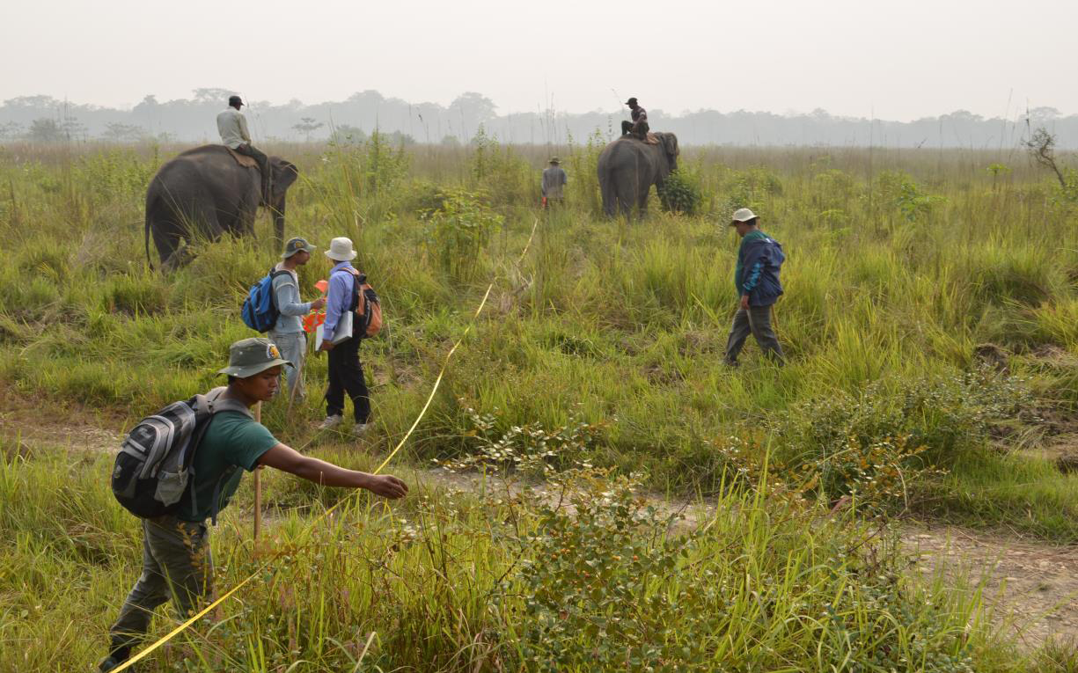
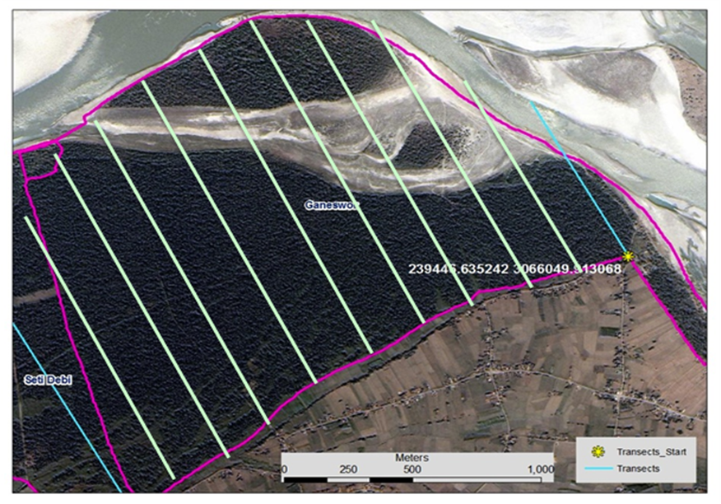
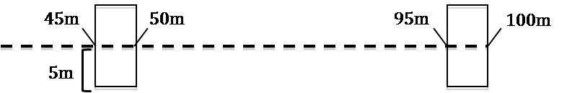
Laying out transects for plot installation
Total Plots: 2219
Year: 2014-2017

Slide 47
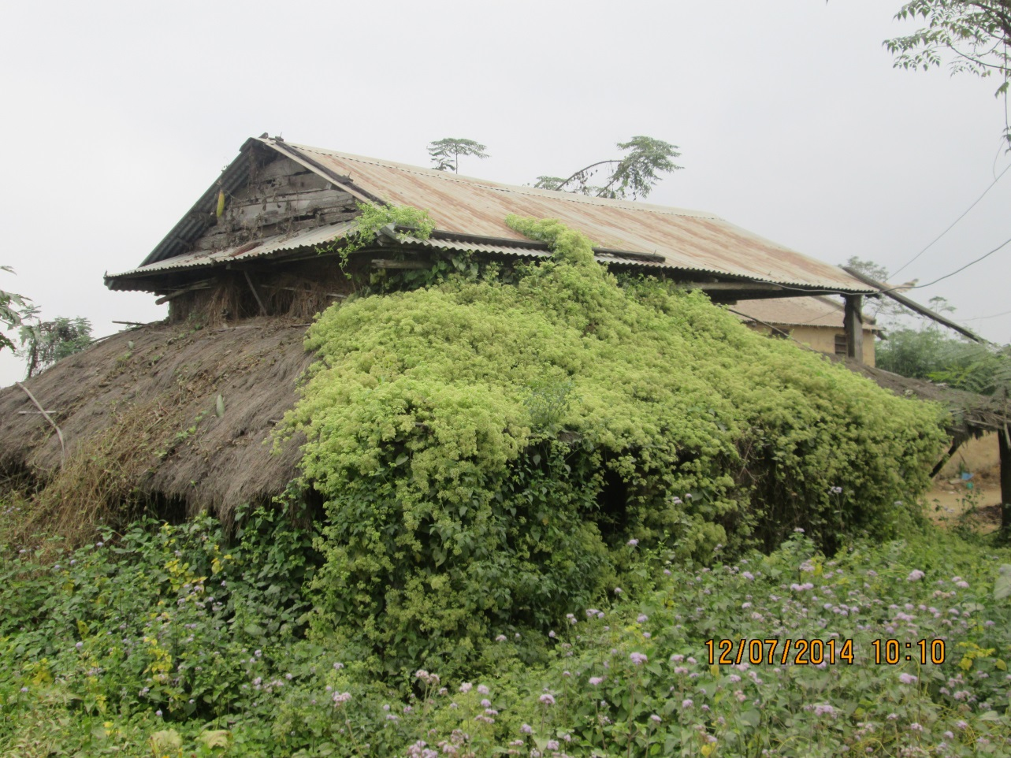
    Mikania Control Intervention in Five Community Forests
    Control (Traditional Management): Banmara (Mikania micrantha) is managed using the conventional method that has long been practiced by forest managers and local communities, involving cutting followed by burning of the biomass
    Treatment 1 (Cutting without Burning): Banmara is controlled through the traditional cutting method; however, the cut biomass is retained on-site and the plot is not burned.
    Treatment 2 (Uprooting with Burning): A modified management approach in which Banmara plants are uprooted, including their root systems, and the resulting biomass is burned within the plot.
    Treatment 3 (Uprooting without Burning): A modified management approach in which Banmara plants are uprooted, including their root systems, and the biomass is left unburned within the plot .

Slide 48
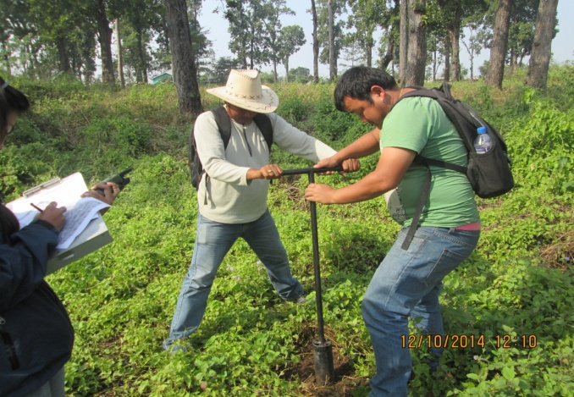
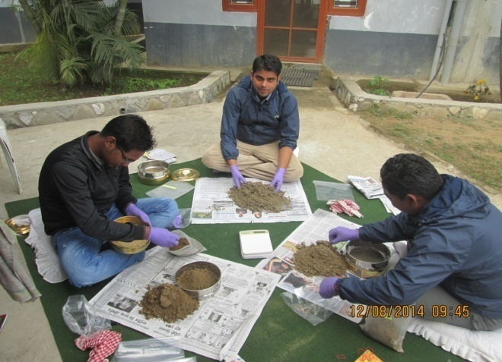
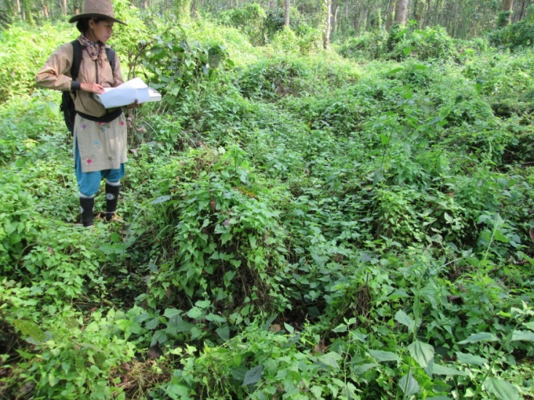
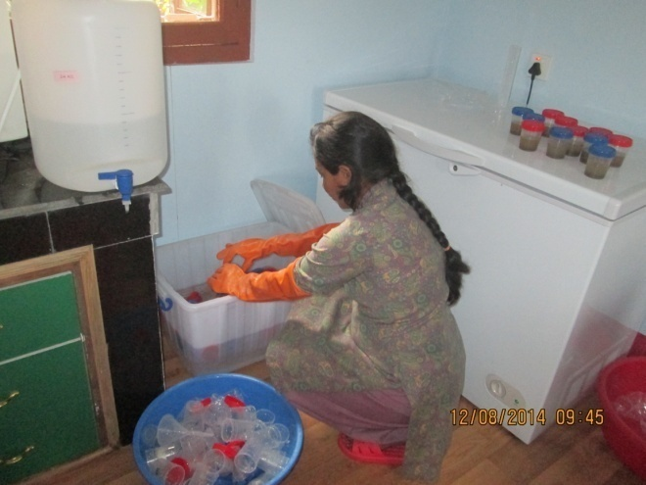
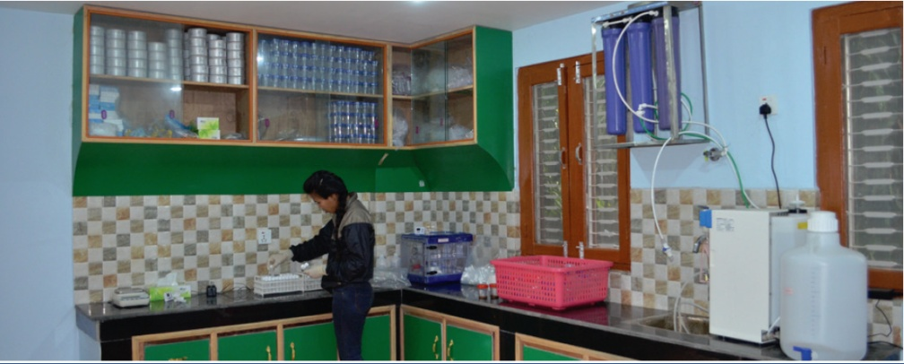
Mikania data collection
Preparation for sample analysis
Soil sample collection
Preparation for soil testing
Soil testing

Slide 49
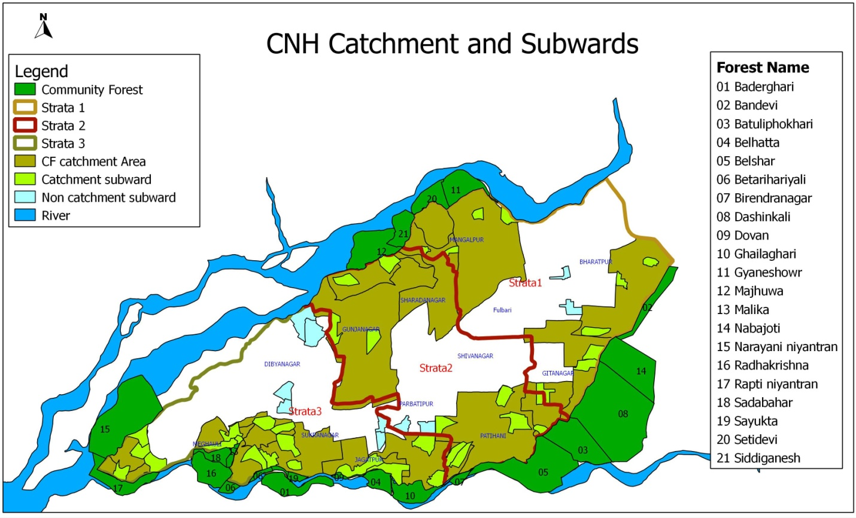
Household Survey Sample

Slide 50
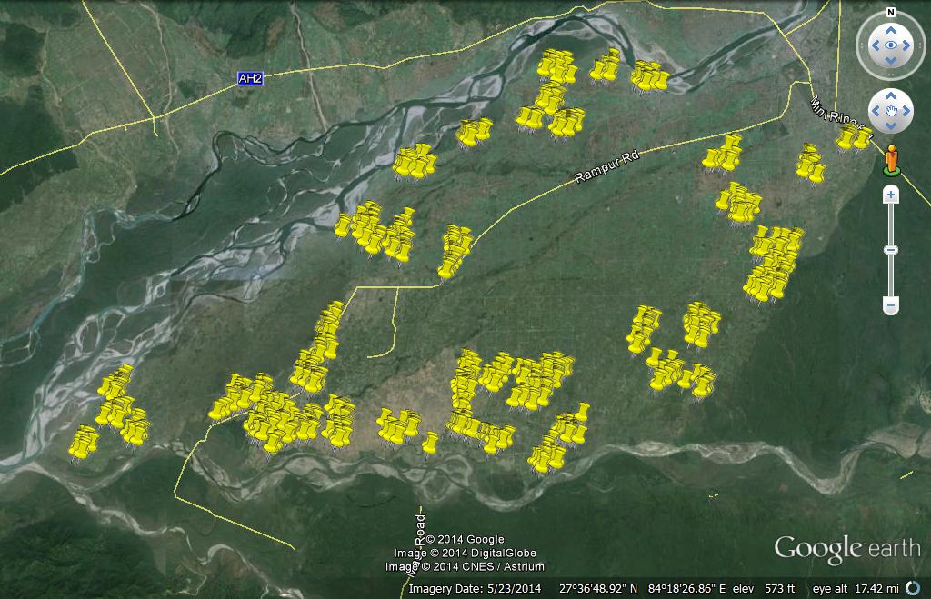
Household Location

Slide 51


Harvest Mapping
 | Time 1 | Time 2
Number of Households | 1231 | 1489
Number of Harvest Maps | 21 | 21

Slide 52



Slide 53

Kaski Area Air Pollution Study (KAPS), Nepal: Investigation of Indoor Solid Fuel and Kerosene Use as Tuberculosis Risk Factor.

Slide 54
Kaski Area Air Pollution Study (KAPS), Nepal: Investigation of Indoor Solid Fuel and Kerosene Use as Tuberculosis Risk Factor.
Objectives
This study, led by Principal Investigator (PI) Michael Bates
To determine whether biomass fuel used for cooking or heating indoor is a risk factor for M. tuberculosis infection or Tuberculosis disease
To determine whether kerosene used as a cooking fuel indoors is a risk factor for M. tuberculosis infection or Tuberculosis disease
To determine whether kerosene used as a lighting fuel indoors is a risk factor for M. tuberculosis infection or Tuberculosis disease
Funding: National Institute of Health (NIH) USA

Slide 55
Kaski Area Air Pollution Study (KAPS), Nepal: Investigation of Indoor Solid Fuel and Kerosene Use as Tuberculosis Risk Factor.
Study Area and Sample:
This is a case-control cohort study. Case comes from TB positive cases from government health facilities – primarily Regional TB Center, Pokhara and surrounding health post from
Kaski, Parbat, Syanja and Baglung
In this study, data was collected through interviews, assessment of blood sugar levels, tuberculosis infection testing, measurement of indoor dust and smoke exposure, and monitoring of individuals exposed to indoor air pollution. These are the primary methods of data collection used in the study
Interviews with tuberculosis (TB) patients - 421
Interviews with healthy individuals- 809
Blood sugar testing - 1230
Tuberculosis infection testing - 809
Indoor air pollution measurement - 1230
Funding: National Institute of Health (NIH) USA

Slide 56
Kaski Area Air Pollution Study (KAPS), Nepal: Investigation of Indoor Solid Fuel and Kerosene Use as Tuberculosis Risk Factor.
Assessment of Air Pollution and Ventilation in the Kitchen and Living Room
This component involves evaluating the levels of air pollution and the ventilation conditions in the kitchen and living room. As part of the ventilation test, a small amount of carbon dioxide (CO₂) gas will be released into the kitchen and living room. A carbon dioxide measuring device will then be used to determine how quickly the concentration of the gas decreases, which helps assess the effectiveness of ventilation in these rooms.
Information collected on household structure, number of family members, types of fuel used for cooking and heating during winter, main and secondary stoves used in the household, fuels used during power outages, the condition and type of the kitchen, use of incense sticks and mosquito-repellent coils, as well as information related to smoking and alcohol consumption.
For the testing of blood sugar and tuberculosis infection, blood samples was collected and sent to the Pokhara laboratory for analysis. Blood samples was collected in the village for this purpose.

Slide 57


HbA1C Test
Kaski Area Air Pollution Study (KAPS), Nepal
Pricking finger tip (n=660)
Provide on the spot result

Slide 58


QuantiFERON Test
Kaski Area Air Pollution Study (KAPS), Nepal
Blood sample collection
Samples delivery to the Lab

Slide 59


Ventilation Measurement of Kitchen
Kaski Area Air Pollution Study (KAPS), Nepal
CO2 Release (n=660 HHs)
Measure AER using Squid

Slide 60


UCB-PATS Monitors in Kitchen
Kaski Area Air Pollution Study (KAPS), Nepal
UCB-PATS device
PM monitoring for 48 hrs

Slide 61


CO Measurement of Kitchen
Kaski Area Air Pollution Study (KAPS), Nepal
Toxi RAE Device
CO measurement for 48 hrs

Slide 62


Stove Use Monitoring (SUMs)
Kaski Area Air Pollution Study (KAPS), Nepal
SUMs
Temperature measurement (48 hrs)

Slide 63


PM2.5 Measurements in Kitchen
Kaski Area Air Pollution Study (KAPS), Nepal
Gravimetric sampler
PM2.5 measurement for 48 hrs

Slide 64


PM2.5 Personal Exposure Measurement
Kaski Area Air Pollution Study (KAPS), Nepal
PM2.5 measurement for 48 hrs
Micro PEM Device

Slide 65
Kaski Area Air Pollution Study (KAPS), Nepal: Investigation of Ocular Disease and Household Fuel Use in Kaski
Objectives
To examine whether household fuel use for cooking, heating, and lighting is associated with cataract (ocular lens opacity) among 453 women in Kaski district, the study was conducted in Pokhara, Nepal, using infrastructure from a previous NIH-funded TB and indoor fuel use study.
It employed both cross-sectional and case-control designs to investigate ocular diseases related to household fuel exposure. The cross-sectional component assessed cataract and dry eye disease among women aged 40–70 years drawn from households included in the earlier TB study. Participants underwent comprehensive eye examinations at Manipal Teaching Hospital in Pokhara.
The case-control component examined age-related macular degeneration (AMD) by comparing diagnosed cases with controls without AMD. Exposure assessment focused on household use of biomass, coal, and kerosene for cooking, heating, and lighting, using data from prior household surveys and indoor air pollution monitoring.

Slide 66
Kaski Area Air Pollution Study (KAPS), Nepal: Investigation of Ocular Disease and Household Fuel Use in Kaski
Dataset/Test:
Demographic information, Cooking, Heating, Lighting, Tobacco smoking, Alcohol, Socio-economic, Health condition (Nutrition, HIV and eye problem) Sun exposure
Eye & sugar test

Slide 67
Kaski Area Air Pollution Study (KAPS), Nepal Investigation of Household Air Pollution & Cardiopulmonary Disease
Objective
To examine whether the type of primary cooking fuel used (LPG, biogas, or wood) is associated with clinical and subclinical cardiovascular abnormalities in Nepali women, with specific attention to blood pressure, cardiac structure/function on echocardiography, ECG abnormalities, and peripheral vascular disease (ankle-brachial index). The researchers specifically hypothesized that solid-fuel (wood) use would be linked to hypertension and its downstream effects increased left ventricular mass, diastolic dysfunction, raised pulmonary artery pressure, and reduced ankle-brachial index relative to gas-based fuels.

Slide 68
Kaski Area Air Pollution Study (KAPS), Nepal Investigation of Household Air Pollution & Cardiopulmonary Disease
Sample
Setting: Kaski District, Nepal (recruited via the existing infrastructure/household list of a separate tuberculosis case-control study), with testing conducted at Manipal Teaching Hospital, Pokhara.
Recruitment: 318 eligible women approached → 301 enrolled (98% participation rate) → 2 excluded (primary fuel was neither LPG, biogas, nor wood) → final analytic sample: 299 women.
Eligibility: Women aged 40–70 years who did most of the household cooking, drawn to achieve a roughly balanced split across the three main local fuel types.
Final breakdown: 195 LPG users, 35 biogas users, 69 wood-stove users.
Data collection period: May 2017 – January 2018.

Slide 69
How Does Climate Change Effects Nepali Farmers' Livelihood Choices
This study investigates the factors that influence farmers’ views of climate risks and potential adaptation strategies in the Chitwan Valley.
What are the major sources of information for farmers in the Chitwan Valley regarding farming and non- farming livelihoods? For example, how much do farmers rely on media and official government sources, vs. their own social networks, to form their views about livelihood risks and opportunities? Are there specific sources that are most trusted by farmers? Are there certain sources that farmers most depend on for how climate and weather may affect their livelihoods?
What is the range and distribution of views regarding climate risks among farmers in the Chitwan Valley? Specifically, are there differences among farmers regarding how much they believe climate change has/will affect their livelihoods? If so, are these differences explained by factors e.g. strength of social networks or exposure to flood risk?
How might farmers’ views about livelihood risks/opportunities be affected by different policy interventions?

Slide 70
Adolescent Compliance with Wrist-Based Air Population Detector
Objectives:
The pilot has two main goals:
The first is to assess whether the adolescent population will follow a study protocol to continuously wear wrist-band air pollution detectors. We want to assess willingness to comply, adherence to the requirement to wear them at all times (24 hours except when bathing), and for what duration we can reasonably request participants to wear monitors (up to two weeks) .
Our second objective is a mechanism experiment to confirm that study respondents are able to interpret information provided by the wrist-bands. The mechanism experiment provides important information for the RCT (Aim 3) to assess the potential for a behavioral response to real time information on air pollution exposures.

Slide 71
CNH2: People, Place, and Payments Study
General Objective
To evaluate the role of payment for ecosystem services on household economic strategies and investment in children’s well-being.
Specific Objective
This project collected survey data from households in Chitwan; the focal site includes community forests to the East of Bharatpur. The survey will include information on household composition, livelihoods, community forest participation, environmental attitudes, and children’s well-being including schooling and time-use.

Slide 72


CNH2: Study on People, Place, and Payments in a Complex Human-Environment System in Eastern Chitwan

Slide 73
CNH2: Study on People, Place, and Payments in a Complex Human-Environment System in Eastern Chitwan
Datasets
1 . Household Census - 822
2. HH Data – 822
3. Child Demographic and educational information – 908
4. House GPS- 822

Slide 74
Integrating Natural Hazards Engineering and Social Demographic to Identify Cumulative Consequences of recurrent Flooding
Objective:
To integrate engineering and social science perspectives to advance understanding of the long- term effects of climate change–induced hazards on rural population dynamics and well-being.
Specific Aims
Aim 1: Identify historical flood events and extents in Chitwan Valley, 1995–2024.Using community-based methods, we will develop a more accurate flood history than official disaster databases by combining neighborhood event histories collected through the calendar method with participatory mapping.

Slide 75
Integrating Natural Hazards Engineering and Social Demographic to Identify Cumulative Consequences of recurrent Flooding
Specific Aims
Aim 2: Develop remote sensing-based flood extents and link them to CVFS neighborhoods. We will integrate community-reported flood information with flood extents derived from openly available satellite imagery to create a spatially explicit record of flooding. These data will be linked to 151 CVFS neighborhoods with detailed longitudinal data on households, agriculture, land use, population dynamics, and health from 1995–2024.
Aim 3: Assess the long-term effects of recurrent flooding on population dynamics, health, and well-being. Using CVFS data, we will examine how flooding affects livelihood strategies, including agricultural change, exits from farming, and international labor migration, as well as household responses such as relocation, children’s school discontinuation, and delayed marriage or childbearing.

Slide 76
Enhancing Social Resilience to Human-Wildlife Conflict
General Objective
This study, led by Principal Investigator (PI) Amy Zuckerwise aims to elucidate the social and ecological characteristics effecting social resilience to increasing tiger presence in Nepal.
Specific Objective
To evaluate social resilience to wildlife, we aim to use social surveys to measure the factors that affect people's livelihood decision-making outcomes in response to increasing tiger populations in the Nepal Terai. These outcomes include remain and absorb risk; adapt by modifying livelihood strategies, transform by switching livelihoods, or exit by migrating. We hypothesize that decision-making abilities are mediated by socio-ecological relationships among people, the environment, and between people and the environment.

Slide 77

Enhancing Social Resilience to Human-Wildlife Conflict
Sample
300 Households
300 Households
Datasets
Census- 600
Household – 600
Calendar – 600 (Farm land , livestock , Fodder collection, Firewood , Income )

Slide 78
Upcoming environment-related funding opportunities (including the Swiss-based Velux Stiftung Foundation)
NPESN website: https://npesn.isernepal.org.np

Slide 79
THANK YOU

